Slide 1

ASHLIN DIVYA
Introduction to Recipe Generator
This project aims to create a simple prompt-based recipe generator to help students explore how AI can be guided to produce creative and practical cooking recipes.
By
Ashlin Divya A

Slide 2

Key Objectives and Desired Outcomes
1
Develop a Reliable Prompt
2
Accommodate Preferences
Structure a prompt that consistently generates relevant and usable cooking recipes.
Ensure the generator can handle dietary restrictions and personal preferences.
3
Produce Balanced Recipes
Generate recipes that are practical, nutritious, and appealing to a wide audience.

Slide 3
Identifying Relevant Ingredients
Common Ingredients
Dietary Considerations
Seasonal Availability
Identify a core set of versatile ingredients that can be used in a variety of recipes.
Consider ingredients that accommodate common dietary restrictions like vegetarian, gluten-free, or nut-free.
Leverage ingredients that are locally and seasonally available for freshness and affordability.

Slide 4
Structuring the Prompt for Recipe Generation
Ingredient List
Preparation Instructions
Clearly specify the key ingredients to be used in the recipe.
Provide guidance on how the ingredients should be prepared.
Cooking Methods
Dietary Needs
Indicate the appropriate cooking techniques, such as baking, sautéing, or grilling.
Communicate any dietary restrictions or preferences to be considered.

Slide 5




Handling Dietary Restrictions and Preferences
Vegetarian
Gluten-Free
Nut-Free
Dairy-Free
Offer meat-free options that are protein-rich and satisfying.
Provide recipes that use gluten-free grains and flours.
Exclude nuts and nut-based ingredients for those with allergies.
Use dairy alternatives like plant-based milks and cheeses.

Slide 6
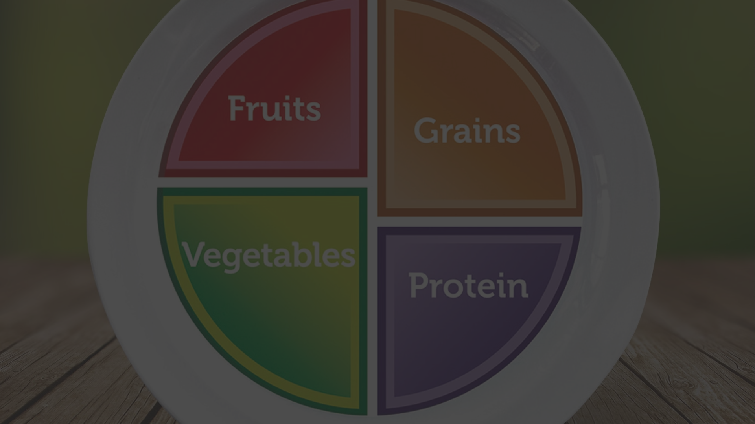



Ensuring Practical and Balanced Recipes
Nutrition
Preparation Time
Ingredient Availability
Ensure recipes provide a balance of macronutrients, vitamins, and minerals.
Keep recipes simple and quick to make for busy home cooks.
Use common, affordable ingredients found in most kitchens.

Slide 7
Evaluating the Generated Recipes
Taste
Ensure the recipe produces a delicious and flavorful dish.
Practicality
Verify the recipe is easy to follow and the instructions are clear.
Nutrition
Assess the nutritional value and balance of the recipe.
Versatility
Determine if the recipe can be easily adapted to different dietary needs.

Slide 8
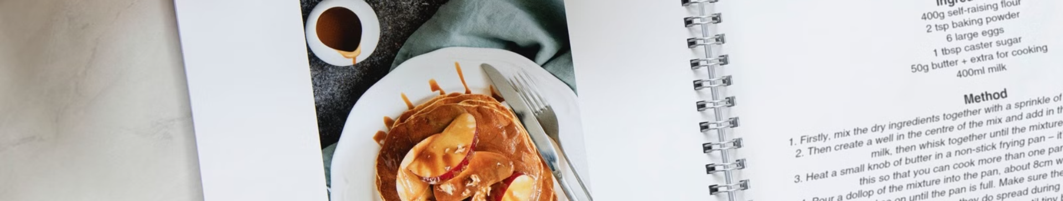
Conclusion and Next Steps
This project has provided a framework for creating a reliable, user-friendly recipe generator. The next steps include implementing the prompt structure, integrating dietary preferences, and thoroughly testing the generated recipes.

